Slide 1
Hexagonal Architecture

Slide 2
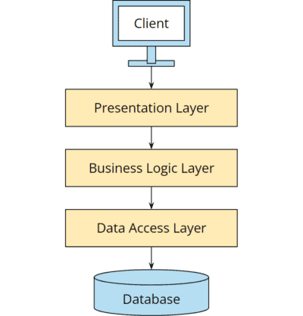
Layered Architecture

Slide 3
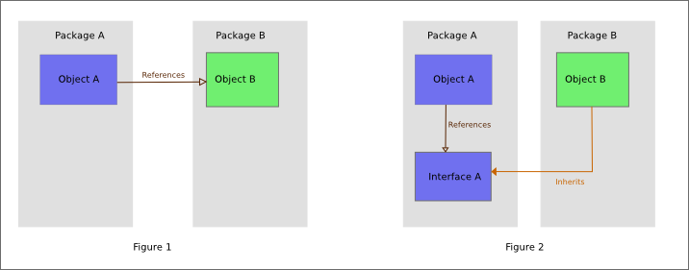
Dependency inversion principle

Slide 4
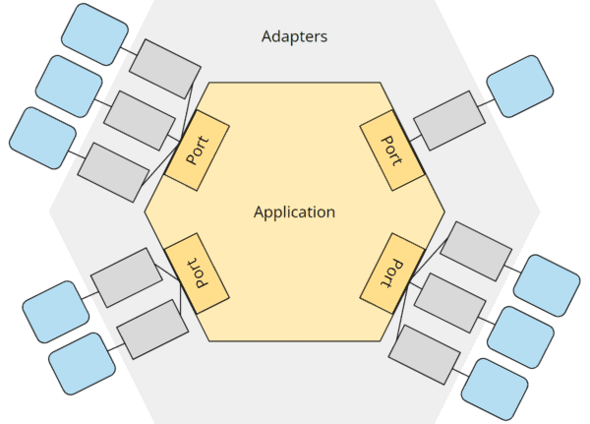
Hexagonal Architecture

Slide 5
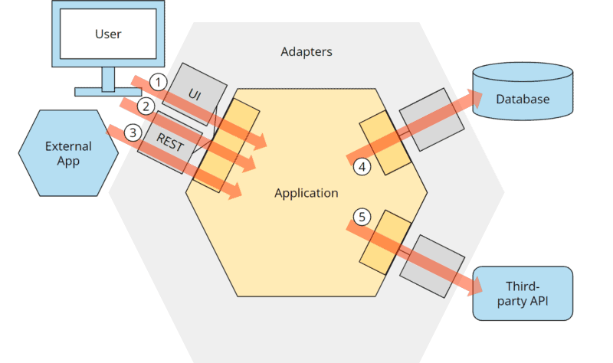
Hexagonal Architecture

Slide 6
Reference
https://www.youtube.com/watch?v=JubdZIdLQ4M
https://www.happycoders.eu/software-craftsmanship/hexagonal-architecture/

